Slide 1
Cloud Service Models

Slide 2
Cloud Communication
Internet-based voice and data communications -----VoIP
Accessed over public internet
Third party
switching
storage
applications

Slide 3
Cloud communication provider
deliver voice & data communications applications and services, hosting them on server
own and maintain, giving their customers access to the “cloud”

Slide 4
Communication-as-a-Service (CaaS):
outsourced enterprise communications solution
leased from a single vendor
VoIP or Internet telephony, instant messaging (IM), collaboration and videoconference applications using fixed and mobile devices.
CaaS vendor is responsible for
all hardware and software management and
offers guaranteed Quality of Service (QoS)

Slide 5
CaaS
offers flexibility and expandability
Suitable for small and medium-sized business ⬅ may not afford
eliminates the business customer’s need for any capital investment in infrastructure
eliminates expense for ongoing maintenance and operations overhead for infrastructure
requires little to no management oversight from customers.

Slide 6
Advantages of CaaS
Hosted and Managed Solutions
Remote management of infrastructure services provided by third parties
delivers a complete communications solution ➔ single vendor
Fully Integrated, Enterprise-Class Unified Communications
voice and data access
manages LAN/ WAN, security, routers, email, voice mail, and data storage.

Slide 7
standard CaaS deployment
Advanced unified communications features
Chat
Multimedia conferencing
Microsoft Outlook integration
Real-time presence
“Soft” phones (software-based telephones)
Video calling
Unified messaging and mobility

Slide 8
Advantages of CaaS
No Capital Expenses Needed:
Outsource company providers supplies a complete solution that fits the company’s exact need
Customers are not required to purchase equipment, so there is no capital outlay
Flexible Capacity and Feature Set
distribute the cost services and delivery across a large customer base
the use of shared feature functionality more economical for customers to implement

Slide 9
Advantages of CaaS
No Risk of Obsolescence
Eg: IC => transistors => 2 years
CaaS vendors must absorb this burden for the user by continuously upgrading the equipment in their offerings to meet changing demands in the marketplace.

Slide 10
Advantages of CaaS
No Facilities and Engineering Costs Incurred
to provide their services to their customers, virtually eliminating the need for customers to maintain data center space and facilities
Monthly/yearly payment

Slide 11
Advantages of CaaS
Guaranteed Business Continuity
If a catastrophic event occurred at your business’s physical location, would your company disaster recovery plan allow your business to continue operating without a break.
Fire, earthquake, physical damages data
Data lose chances
Monthly/yearly payment

Slide 12
Infrastructure-as-a-Service (IaaS):
includes the capability to provision processing, storage, networks, and other fundamental computing resources
the consumer is able to deploy and run arbitrary software, which can include operating systems and applications
consumer does not manage or control the underlying cloud infrastructure but has control over operating systems; storage, deployed applications, and possibly limited control of select networking components

Slide 13
popular IaaS solutions
Compute as a service:
provides compute capacity that includes
servers,
operating system access,
firewalls,
routers and load balancing on demand

Slide 14
popular IaaS solutions
Web hosting:
Moving a website to an IaaS based model ensures that the website won’t get bogged down during peak traffic times
Storage as Service
a business model in which a large company rents space in their storage infrastructure to a smaller company or individual

Slide 15
popular IaaS solutions
Disaster recovery and backup as a service:
to ensure that organizations have uninterrupted access
to data and applications,
regardless of emergencies, such as power outages, natural disasters or system failure
redundancy and automatic failover to ensure ongoing access, reducing downtime to nearly zero
two basic options : when it comes to disaster recovery as a service
backup and restore from the cloud
backup and restore to the cloud

Slide 16
backup and restore from the cloud
applications and data on their own premise
back up data to the cloud and restore it to hardware on their own premise when a disaster occurs

Slide 17
backup and restore to the cloud
data is restored to virtual machines in the cloud

Slide 18
popular IaaS solutions
Desktops as a service DaaS:
solely for hosting and serving virtual desktops.
allows enterprises to quickly provision, access, run and deactivate virtual desktop machines as needed.

Slide 19
popular IaaS solutions
Servers as a service
to secure, private areas dedicated to the organization’s use, so security is ironclad.
Networking as a service:
the newest entrant
to offer networking resources on demand in order to support virtual networks — resources such as firewalls, load balancing and WAN acceleration services

Slide 20
Modern On-Demand Computing:
on-demand model evolved to overcome the challenge of being able to meet fluctuating resource demands efficiently
Eg; Amazon’s Elastic Compute Cloud (Amazon EC2).
web service that provides resizable computing capacity in the cloud.

Slide 21
Amazon Web Services: AWS
http://aws.amazon.com
First cloud computing service provider
Beta version
Elastic Computing platform called EC2
in August 2006

Slide 22
AMAZON EC2 SERVICE:
EC2 = Elastic Cloud Computing
Web service with a simple interface for launching instances of an application under several operating systems
allows a user to load instances of an application with
a custom application environment,
manage networks access permissions, and
run the images using as many or as few systems as desired
based on the Xen virtualization strategy

Slide 23
each virtual machine functions as a virtual private server and is called an instance
specifies the maximum amount of resources available to an application
that provides resizable computing capacity in the cloud

Slide 24
Advantages of EC2
It is a web service interface that allows customers to obtain and configure capacity with minimal effort.
It provides users with complete control of their (leased) computing resources and lets them run on a proven computing environment.
It reduces the time required to obtain and boot new server instances to minutes, allowing customers to quickly scale capacity as their computing demands dictate.
It changes the economics of computing by allowing clients to pay only for capacity they actually use.
It provides developers the tools needed to build failure-resilient applications and isolate themselves from common failure scenarios.

Slide 25
Relation between User & EC2
SOAP messages
application protocol
developed in 1998
for Web applications
based on the Extensible Markup Language
uses TCP and more recently UDP transport protocols
SOAP messages
EC2
user

Slide 26
SOAP
AMI image
Boot instance
EC2
allows the import of virtual machine images from the user environment to an instance through a facility called VM import
distributes automatically the incoming application traffic among multiple instances using the elastic load balancing facility

Slide 27
To be able to connect to a virtual machine in a cloud, a client must know its IP address
EC2 Private IP Address
internal address of an instance
used for routing within the EC2Cloud
EC2 Public IP Address
outside the EC2network
is translated using the Network Address Translation to the private IP address
EC2 Elastic IP Address:

Slide 28
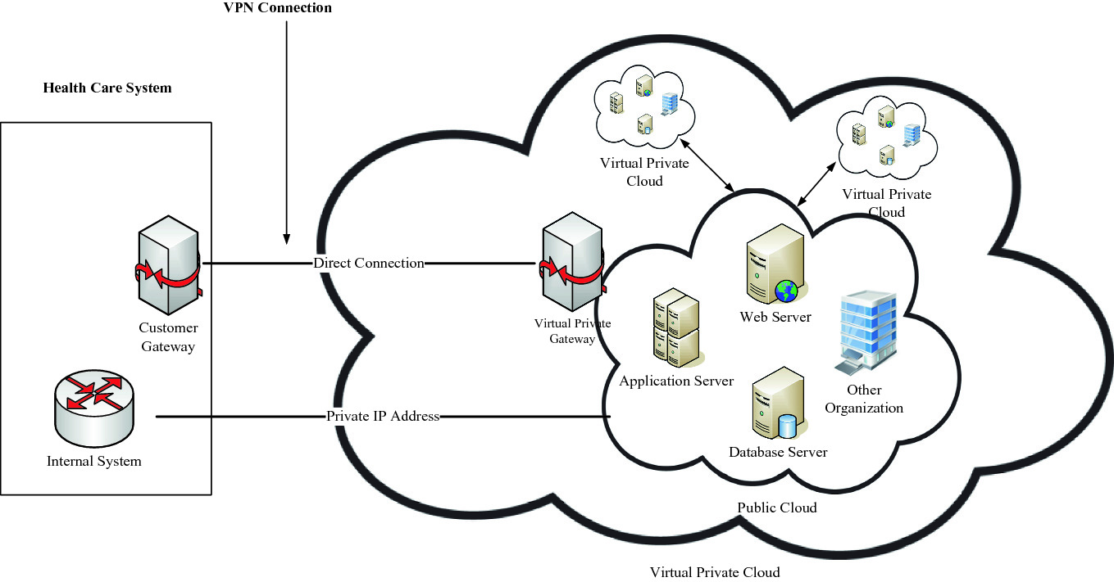
EC2 Private IP Address
internal address of an instance
used for routing within the EC2Cloud

Slide 29
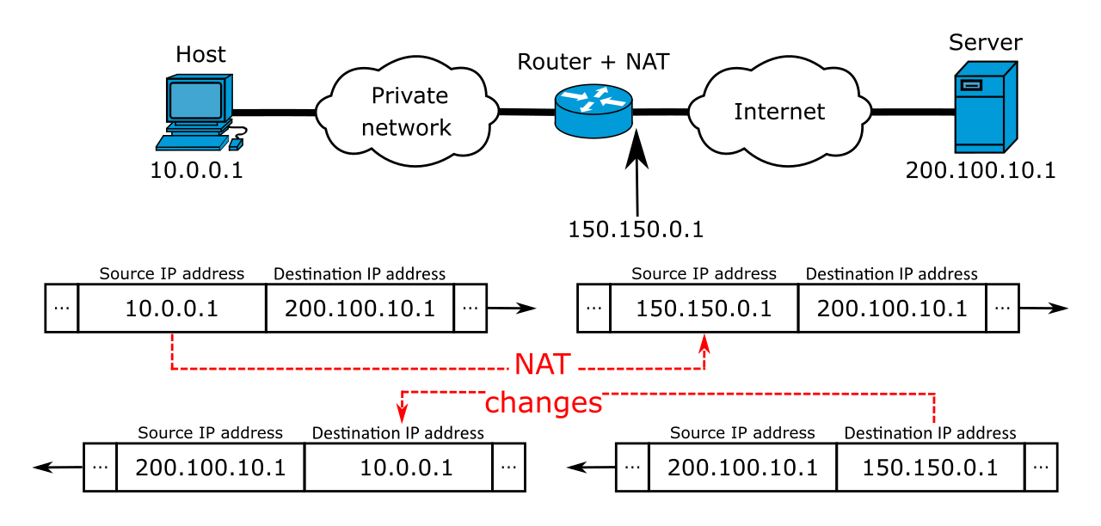
EC2 Public IP Address
outside the EC2network
is translated using the Network Address Translation to the private IP address

Slide 30
EC2 Elastic IP Address:
NAT
Private IP address
Elastic IP address
allocated to an AWS EC2 account until
used by traffic originated outside the EC2cloud
a static IPv4 address designed for dynamic cloud computing.
can mask the failure of an instance or software by rapidly remapping the address to another instance in your account.
Alternatively, you can specify the Elastic IP address in a DNS record for your domain, so that your domain points to your instance.

Slide 31
Amazon EC2 Service Characteristics:
Dynamic Scalability
Full Control of Instances
Configuration Flexibility
Integration with Other Amazon Web Services
Reliable and Resilient Performance Amazon Elastic Block Store (EBS)
Support for Use in Geographically Disparate Locations

Slide 32
Dynamic Scalability
enables users to increase or decrease capacity
invoke a single instance, hundreds of instances, or even thousands of instances simultaneously
dynamic scalability web service application

Slide 33
Full Control of Instances
complete control of their instances
have root access
Instances can be rebooted remotely using web service APIs

Slide 34
Configuration Flexibility
allows them to select a configuration of memory, CPU, and instance storage
OS Configuration
Linux distributions
Microsoft Windows Server
OpenSolaris
Configuration
MEMORY SPACE
Virtual Memory / Cache
CPU
RAM
STORAGE

Slide 35
Integration with Other Amazon Web Services
to provide a complete solution for computing, query processing, and storage across a wide range of applications
Amazon web services
Amazon SimpleDB
Amazon Simple Queue Service (Amazon SQS)
Amazon CloudFront
Amazon Simple Storage Service (Amazon S3)

Slide 36
Amazon S3
provides a web services interface that allows users to store and retrieve any amount of data from the Internet at any time, anywhere.
It gives developers direct access to the same highly scalable, reliable, fast, inexpensive data storage infrastructure Amazon uses to run its own global network of web sites.
The S3 service aims to maximize benefits of scale and to pass those benefits on to developers.

Slide 37
Amazon SimpleDB
web-based service,
designed for running queries on structured data stored with the Amazon Simple Storage Service (Amazon S3) in real time.
to provide users the capability to store, process, and query data sets within the cloud environment. ➔ with EC2
designed to make web-scale computing easier and more cost effective for developers.

Slide 38
Amazon Simple Queue Service (Amazon SQS)
is a reliable, scalable, hosted queue for storing messages as they pass between computers.
developers can move data between distributed components of applications that perform different tasks without losing messages or requiring 100% availability for each component.
works by exposing Amazon’s web-scale messaging infrastructure as a service.
Any computer connected to the Internet can add or read messages without the need for having any installed software or special firewall configurations.
Components of applications using Amazon SQS can run independently and do not need to be on the same network, developed with the same technologies, or running at the same time.

Slide 39
Amazon CloudFront
is a web service for content delivery.
to distribute content to end users with low latency and high data transfer speeds. ➔ AWS
delivers content using a global network of edge locations.
Requests for objects are automatically routed to the nearest edge server, so content is delivered with the best possible performance.

Slide 40
Reliable and Resilient Performance Amazon Elastic Block Store (EBS)
provides users powerful features to build failure-resilient applications.
offers persistent storage for Amazon EC2 instances.
Amazon EBS volumes are highly available, highly reliable data shares that can be attached to a running Amazon EC2instance and are exposed to the instance as standard block devices.
Amazon EBS volumes are automatically replicated on the back end.

Slide 41
Support for Use in Geographically Disparate Locations
Amazon EC2 provides users with the ability to place one or more instances in multiple locations.
Amazon EC2 locations are composed of Regions (such as North America and Europe) and Availability Zones.
By launching instances in any one or more of the separate Availability Zones, one can insulate their applications from a single point of failure.
Amazon EC2 is currently available in two regions, the United States and Europe.

Slide 42
Elastic IP Addressing
static IP addresses designed for dynamic cloud computing
An Elastic IP address is associated with your account and not with a particular instance, and you control that address until you choose explicitly to release it.

Slide 43
Monitoring-as-a-Service (MaaS):
emerging piece of the Cloud
outsourced provisioning of security, primarily on business platforms that leverage the Internet to conduct business.
Security monitoring involves protecting an enterprise or government client from cyber threats.
Many industry regulations require organizations to monitor their
security environment, server logs, and other information assets
to ensure the integrity of these systems

Slide 44
Two important things:
The total cost of ownership (TCO) for traditional security operations centers (SOCs) is much higher than for a modern-technology security operations centers (SOC);
achieving lower security operations costs and higher security effectiveness means that modern SOC architecture must use security and IT technology to address security risks

Slide 45
Typical services provided by many MaaS vendors
Early Detection
Platform, Control, and Services Monitoring
Intelligent Log Centralization and Analysis
Vulnerabilities Detection and Management
Continuous System Patching/Upgrade and Fortification
Intervention, Forensics, and Help Desk Services

Slide 46
Early Detection
detects and reports new security vulnerabilities shortly after they appear
usually sent by email
Vulnerability reports contains:
detailed description of the vulnerability and the platforms affected,
also include information on the impact the exploitation of this vulnerability
the report also indicates specific actions to be taken to minimize the effect of the vulnerability, if that is known

Slide 47
Platform, Control, and Services Monitoring
dashboard interface and makes it possible to know the operational status of the platform
accessible from a web interface, making remote access possible
operational status indicator
By detecting and identifying such problems, preventive measures can be taken to prevent loss of service

Slide 48
Intelligent Log Centralization and Analysis
monitoring solution based mainly on the correlation and matching of log entries’
helps to establish a baseline of operational performance
provides an index of security threat

Slide 49
Vulnerabilities Detection and Management
automated verification and management of the security level of information systems
periodically performs a series of automated tests for the purpose of identifying system weaknesses ==➔ loop holes / functions

Slide 50
Continuous System Patching/Upgrade and Fortification
is enhanced with continuous system patching and upgrading of systems and application software
operating system are necessary to maintain adequate security levels and support new versions of installed products

Slide 51
Intervention, Forensics, and Help Desk Services
When a detected threat is analyzed, it often requires forensic analysis to determine what it is, how much effort it will take to fix the problem, and what effects are likely to be seen

Slide 52
The Traditional On-Premises Model
Means building and running on-premises applications
Each application was designed to meet specific business requirements. Each solution required a specific set of hardware, an operating system, a database, often a middleware package, email and web servers, etc
complex, expensive, and risky

Slide 53
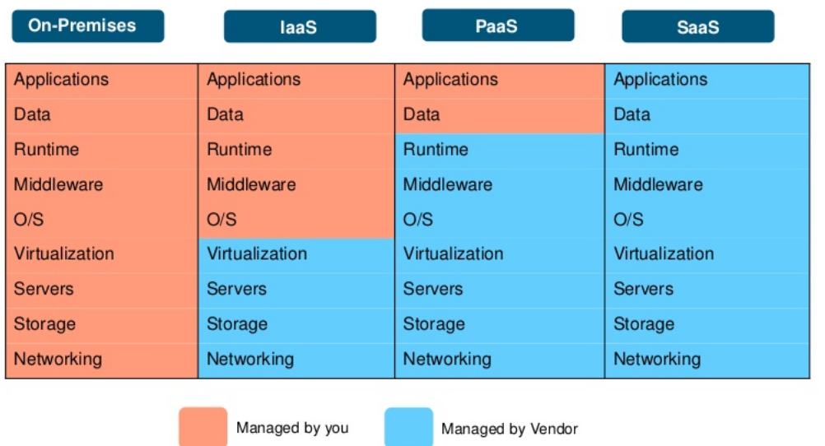
New Cloud Model
{

Slide 54
Key Characteristics of PaaS
include services to develop, test, deploy, host, and manage applications to support the application development life cycle
include services for
concurrency management,
scalability,
fail-over and
Security
integration with web services and databases
Write the key characteristics of IaaS and SaaS

Slide 55
SaaS Implementation Issues
This reduce the time to market and cost of converting a traditional on-premises product
According to Microsoft SaaS architectures, SaaS architecture is classified into 4 level maturity levels whose key attributes are :
ease of configuration,
multitenant efficiency, and
scalability

Slide 56
SaaS Architectural classified into 4 levels
SaaS Architectural Maturity Level 1—Ad-Hoc/Custom
SaaS Architectural Maturity Level 2—Configurability
SaaS Architectural Maturity Level 3—Multitenant Efficiency
SaaS Architectural Maturity Level 4—Scalable

Slide 57
SaaS Architectural Maturity Level 1 —Ad-Hoc/Custom
actually no maturity at all
Each customer has a unique, customized version of the hosted application
Migrating a traditional non-networked or client-server application
requires the least development effort and reduces operating costs

Slide 58
SaaS Architectural Maturity Level 2 —Configurability
many customers can use separate instances of the same application
varying needs of each customer by using detailed configuration options
to ease the maintenance burden by being able to update a common code base

Slide 59
SaaS Architectural Maturity Level 3 —Multitenant Efficiency
a single program instance that has the capability to serve all of the vendor’s customers
ultimately this level is limited in its ability to scale massively

Slide 60
SaaS Architectural Maturity Level 4 —Scalable
capable of supporting a load-balanced farm of identical application instances running on a variable number of servers, sometimes in the hundreds or even thousands
increased or decreased to match load demand by adding or removing servers, applications, etc.

Slide 61
Write the benefits of IaaS, PaaS, and SaaS?

Slide 62
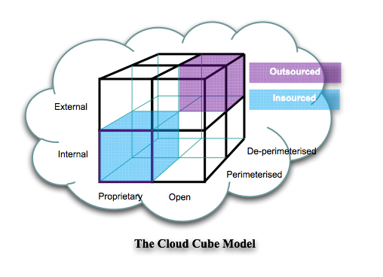
Jericho Cube Model

Slide 63
As the name Four-Dimensional, the working is also categorized into four parts
Physical Location of Data: The location of data may be internally or externally which ultimately defines the organization's boundary.
Ownership: Ownership is proprietary or open; is a measurement for not only ownership of technology but also its interoperability, use of data & ease of data-transfer & degree of vendor's application's lock-in.
Security Range: is parameterized or de-parameterized; which measures whether the operations are inside or outside the security boundary, firewall, etc.
Sourcing: In-sourcing or out-sourcing; which defines whether the customer or the service provider provides the service.

Slide 64
XaaS- Anything as a service
Hybrid
one or a combination of Software as a Service (SaaS), Infrastructure as a Service (IaaS), Platform as a Service (PaaS). communications as a service (CaaS) or monitoring as a service (Maas)
emerging as a term

